Slide 1



Navigating the City That Never Sleeps: A Visual Exploration of NYC Taxi Data
Capstone Project - Fall 2023
Masters in Information Technology and Analytics
Kireeti Mantrala - sm2594

Slide 2


Introduction
The aim of this project is to gain insights into the activities of NYC Yellow taxis (Medallion taxis), including identifying popular areas, peak times and days of high activity, estimating average trip costs, and determining which areas tend to have higher tipping rates. Further understanding and comparing our data to current trends. This information could prove valuable for taxi drivers seeking to optimize their earnings by knowing where and when to focus their efforts, as well as for passengers aiming to navigate around traffic congestion.

Slide 3
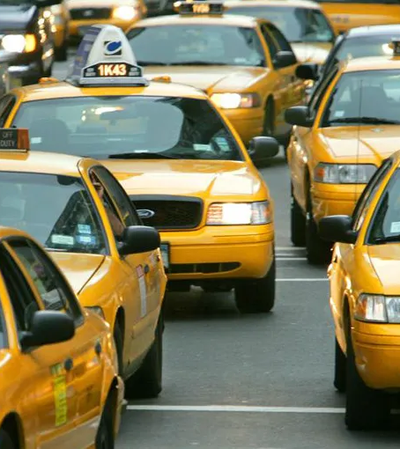
About the Data
This dataset delves into the dynamic realm of NYC yellow taxi operations, utilizing a comprehensive dataset sourced from ”NYC Taxi and Limousine Comission”.
To ensure precision and relevance, I cleaned the dataset and organized it into distinct tables tailored to my analytical needs, thus paving the way for compelling visuals in Tableau.
In addition to the raw dataset, I have enriched the analysis by incorporating supplementary data from online sources, thereby enhancing the depth and breadth of insights derived.

Slide 4

Visualizing Yellow Taxi Trips
Median Price:
Explore the average fares for taxi trips in boroughs which is sum of median price. With navigation that shows Trip distance Median.
Trip Duration in the Boroughs:
Analyze how trip durations vary across the different boroughs of New York City.
Tip Rates Table:
Uncover the tipping habits of passengers in pickup boroughs, divided as percentages in multiples of 5 and added a column no tip.
Top Three Boroughs:
Discover which boroughs have the highest number of taxi trips and further analyze the reasons behind their popularity.
Manhattan 2016:
This line graph shows the peak of trips touch around 450k within the six months of 2016 along with two major declines in the same graph.
Week Clock:
This is an hourly clock visual for each day in a week for our data visualized with number of trips in a day and night pattern.
By Hour Analysis:
This visual shows us the analysis by hour with average of trips.
Borough Overview:
Shows the map view of the boroughs along with EWR, highlighting Manhattan.

Slide 5
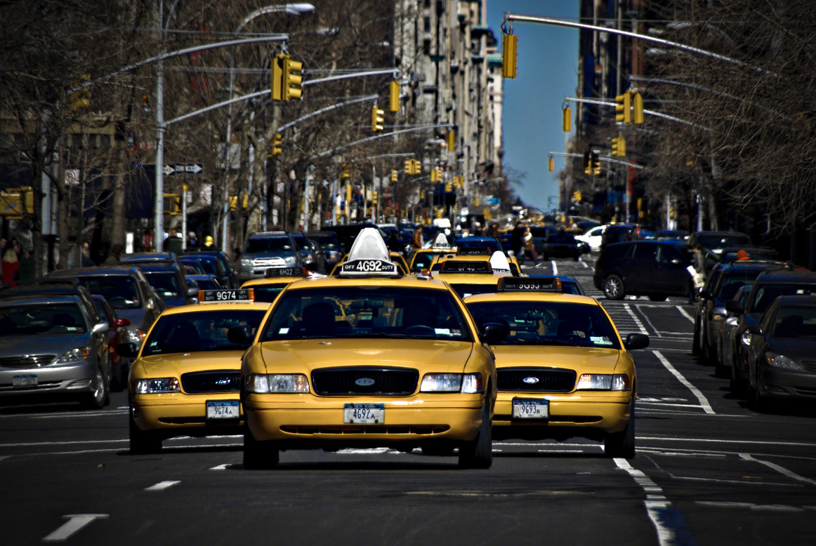
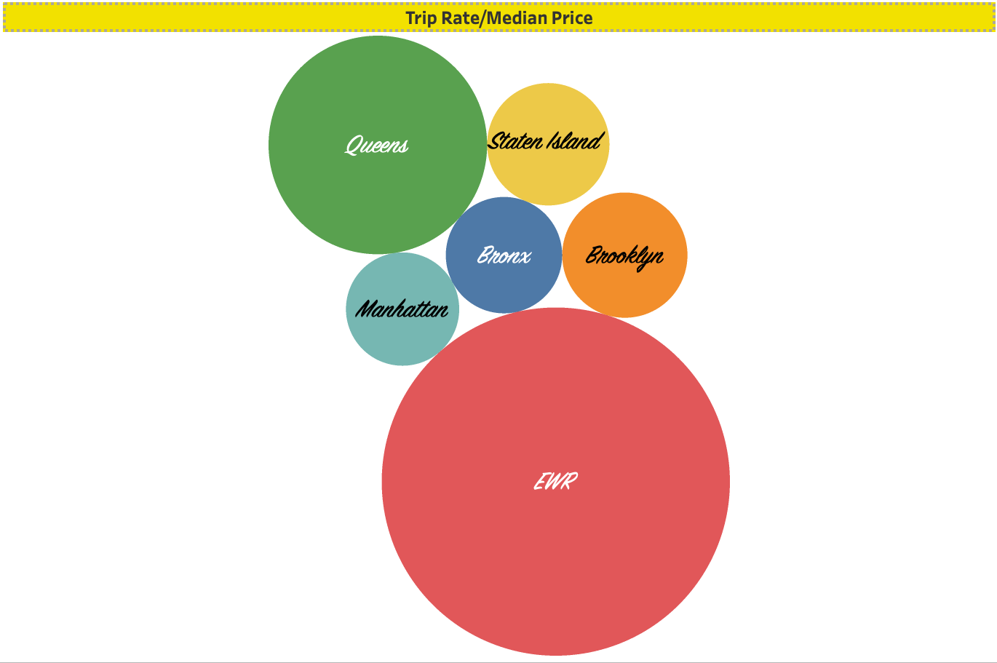
Visual -1

Slide 6
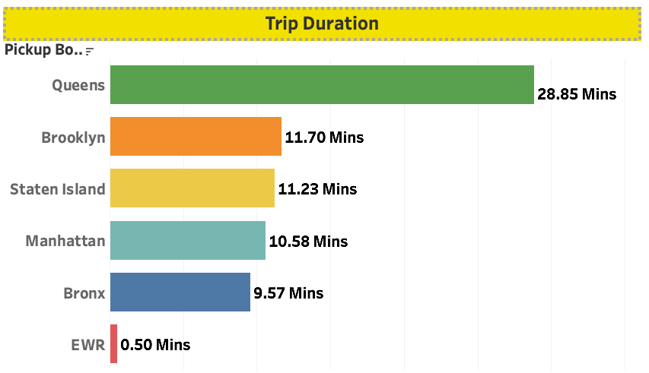
Visual -2

Slide 7
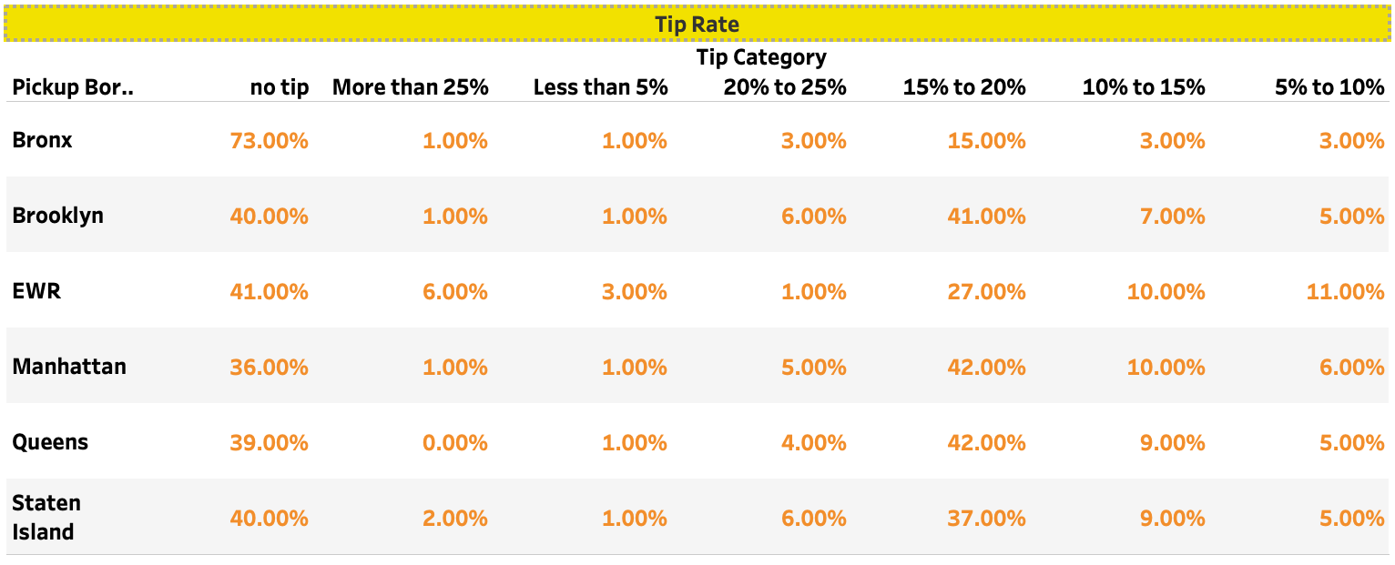
Visual -3

Slide 8
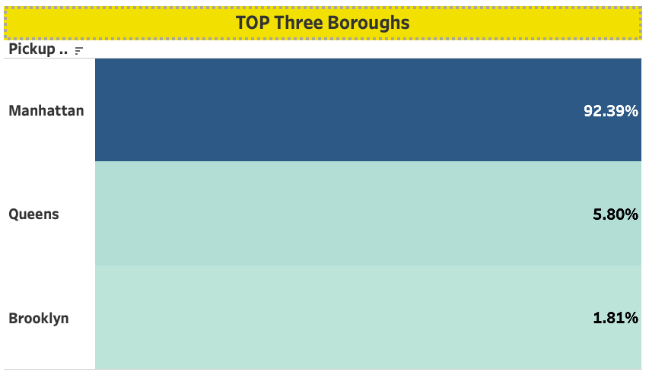
Visual -4

Slide 9
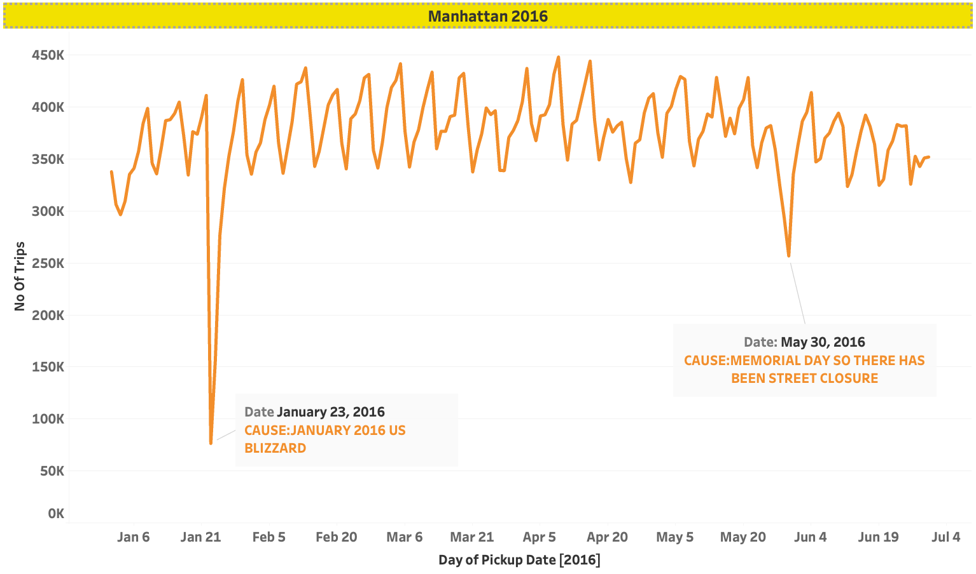
Visual -5

Slide 10
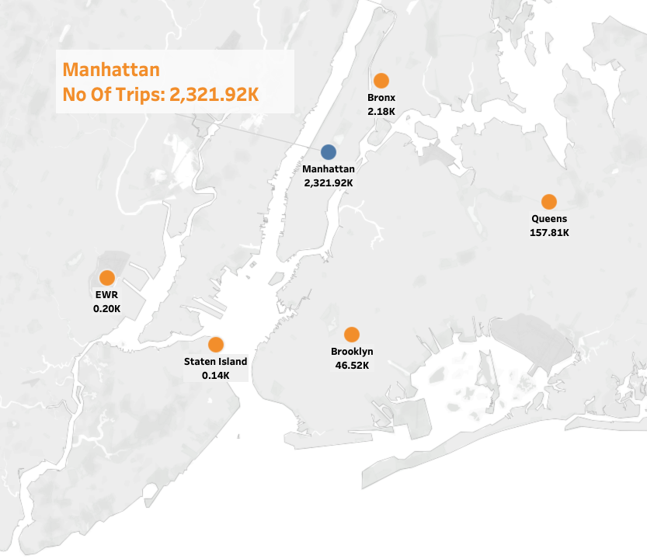
Visual -6

Slide 11
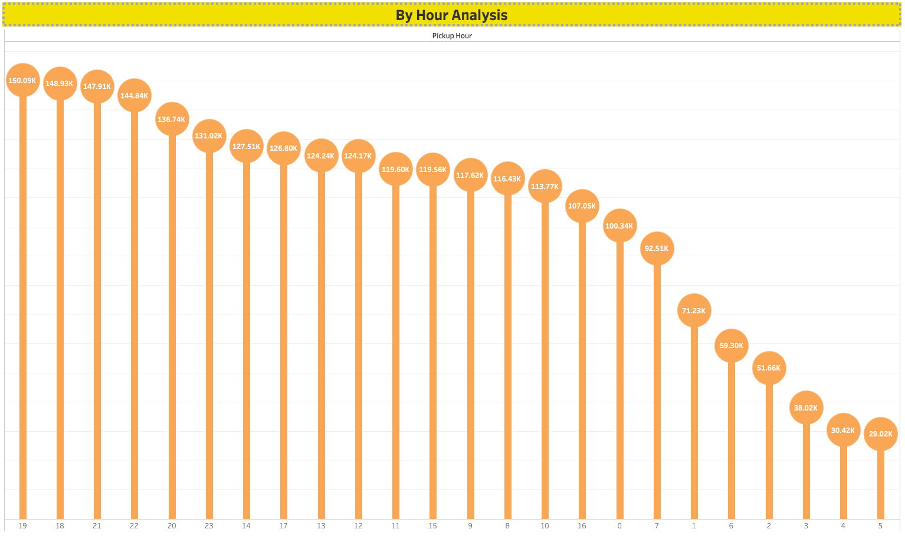
Visual -7

Slide 12
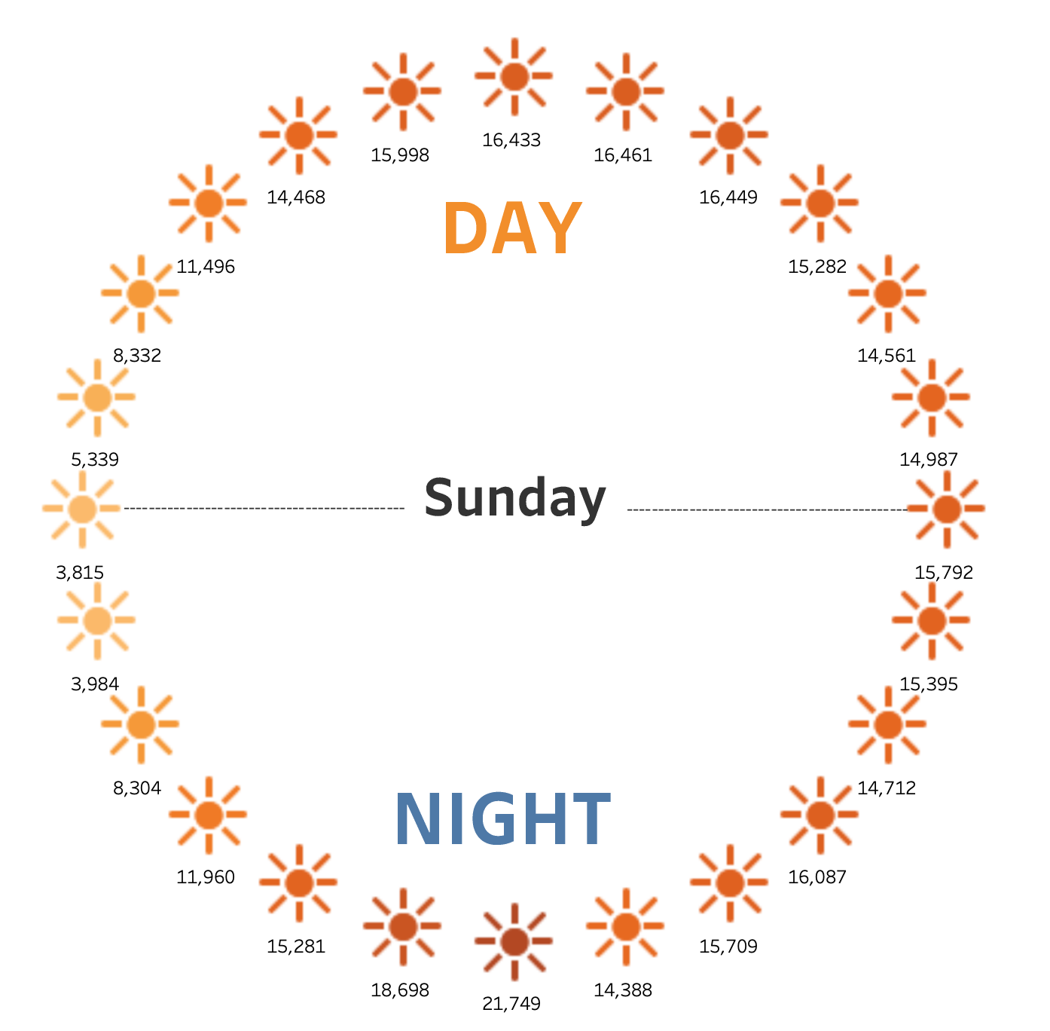
Visual -8

Slide 13
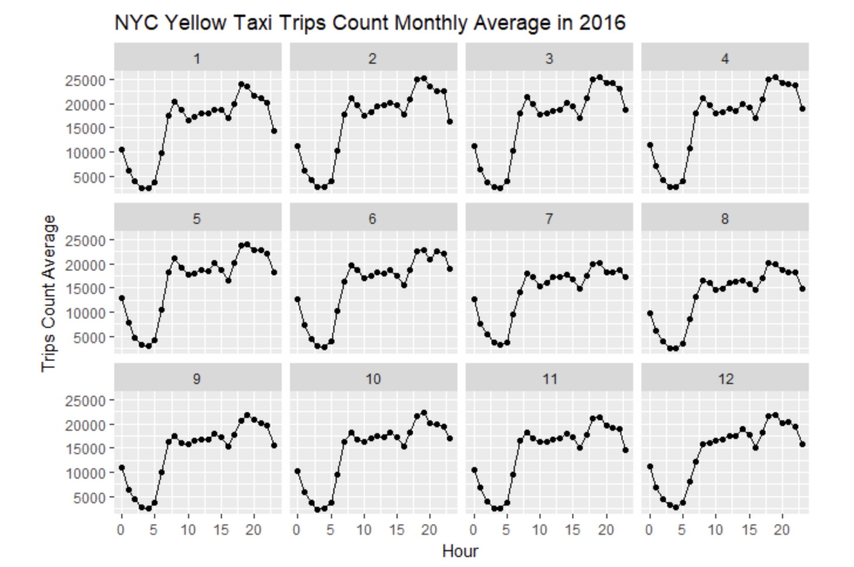
Visual -A

Slide 14
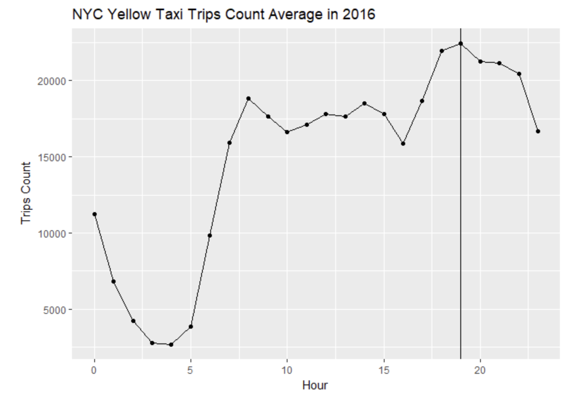
Visual -B

Slide 15

Insights and Learnings
With the visual data that I have created and analyzed, The analysis of NYC taxi data reveals several meaningful insights about the patterns and preferences of taxi rides across different boroughs. The NYC Yellow taxi data analysis provides valuable insights into the dynamics of taxi usage across boroughs, shedding light on preferences, temporal trends, and external factors influencing travel patterns. Understanding these trends can inform transportation service providers, policymakers, and commuters alike in optimizing taxi services and planning for various contingencies.

Slide 16

Thank you

